Slide 1
Nutrients

Slide 2
Biologically essential nutrients

Slide 3
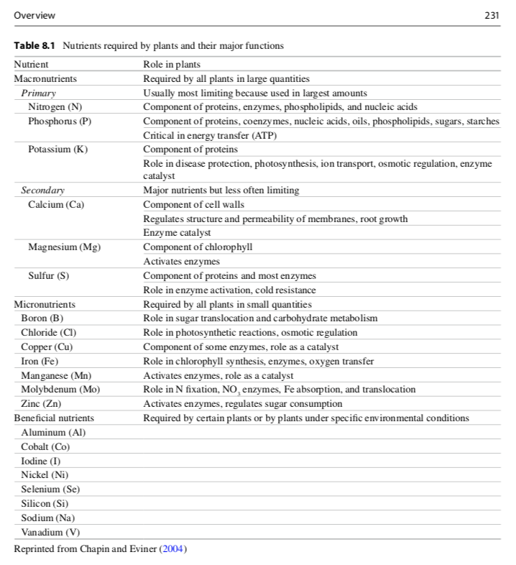

Slide 4
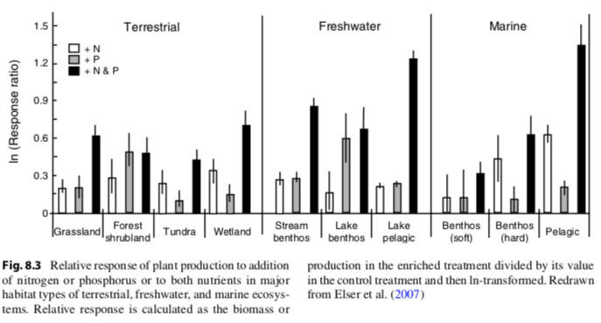
Nutrients limit productivity (N and P)

Slide 5
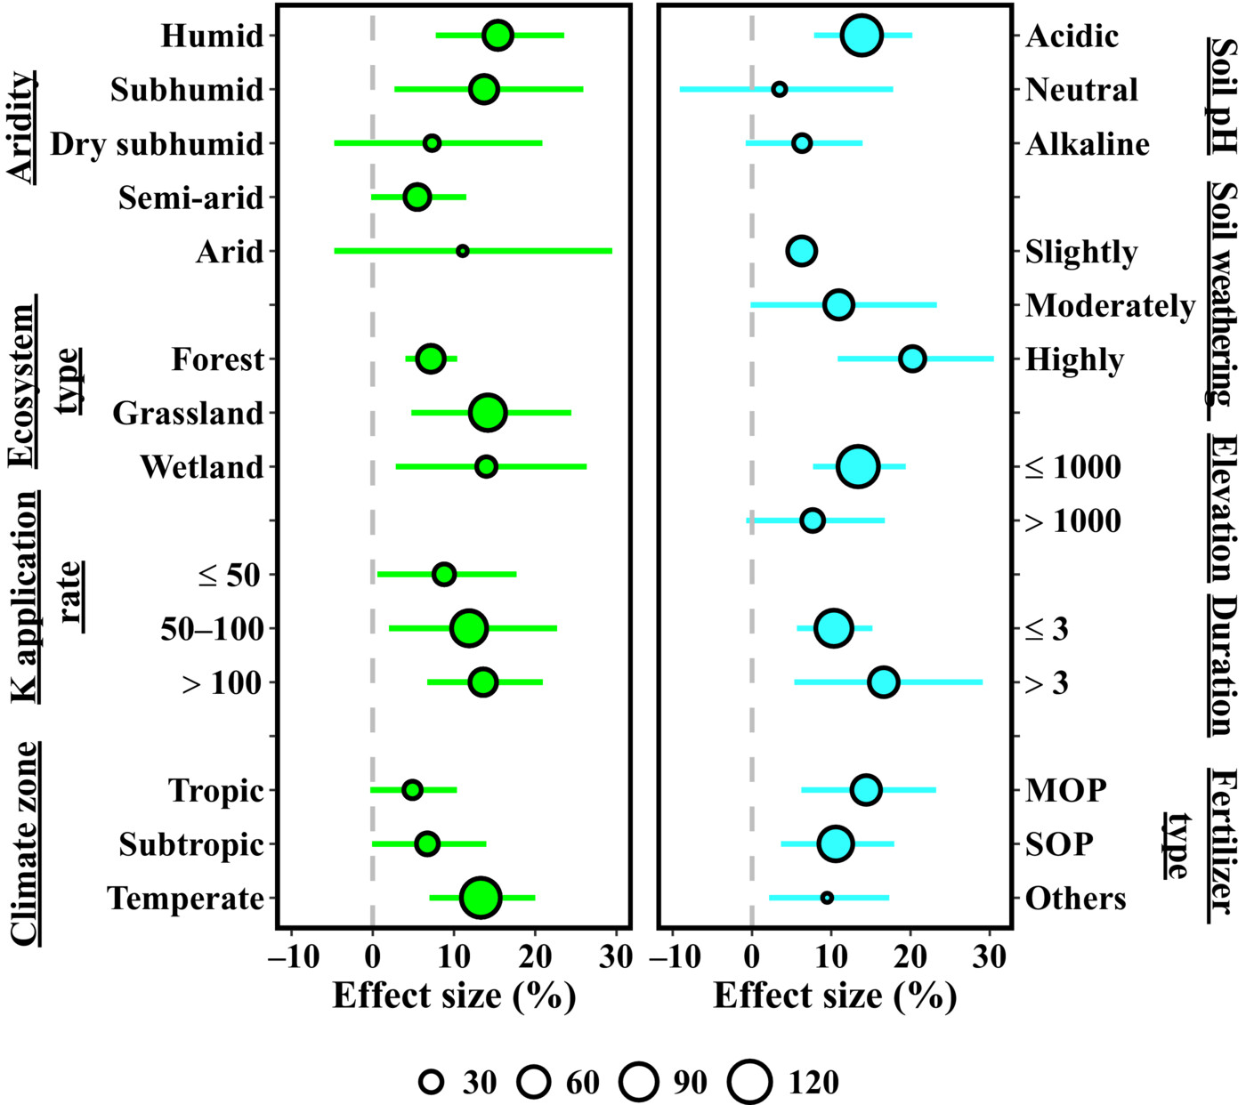
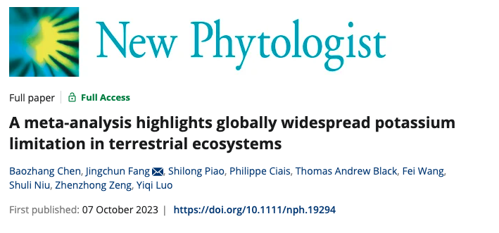
Nutrient limit productivity (also K!)

Slide 6
Nutrient cycling

Slide 7
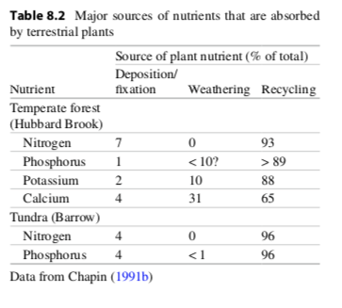
Nutrients cycle through ecosystems differently

Slide 8
Nutrients cycle through ecosystems differently

Slide 9
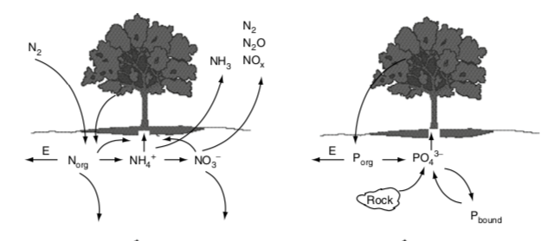

Slide 11
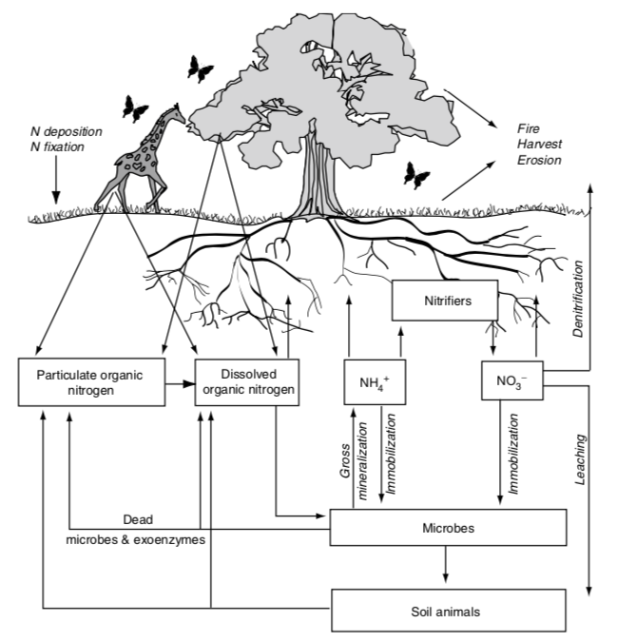
The terrestrial N cycle

Slide 12
The terrestrial N cycle
Nitrogen is constantly changing forms due to biological organisms

Slide 13
The terrestrial N cycle
Bacteria
Fungi
Nitrogen is constantly changing forms due to biological organisms (mostly microbes)
USDA

Slide 14
Important N forms
N₂
Nitrogen gas
Lots in the atmosphere
Cannot be taken up by plants or most microbes (just N fixers)
NO₃⁻
Nitrate
Highly mobile
Can be easily taken up by plants and most microbes
NH₄⁺
Ammonium
Mobile
Can be easily taken up by plants and most microbes
Dissolved organic N (DON)
Organic (contains C)
Produced by dead organisms
Cannot be taken up by plants
Can be broken down by microbes

Slide 17
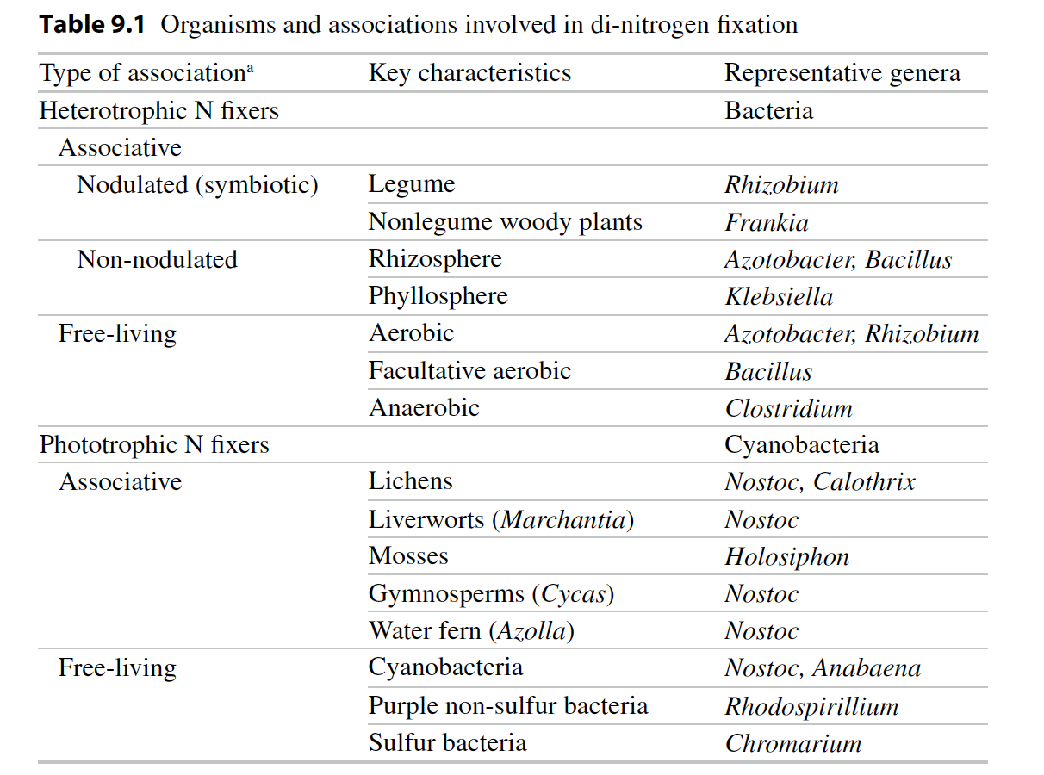
Biological N fixation: N₂ → NH₃

Slide 18
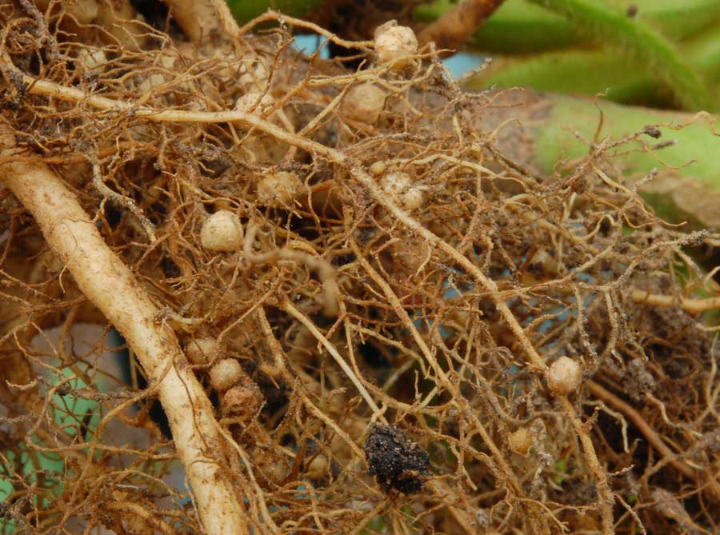
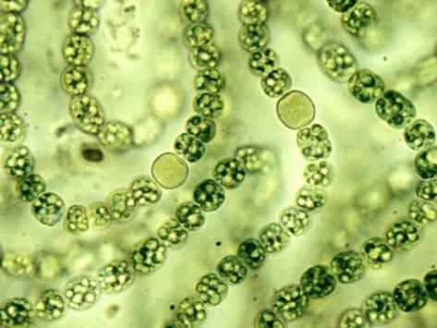
Nodules
Heterocysts
Soil Aggregates

Slide 19
Questions to ponder
Why wouldn’t all plants associate with N fixing bacteria?
Where would you expect to find plants that associate with N fixing bacteria?

Slide 20
Why this pattern??
Menge et al. (2019)

Slide 22
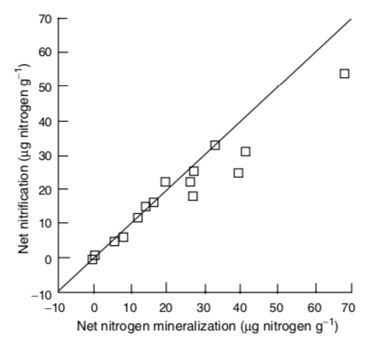
Nitrification: NH₃ → NO₂ → NO₃
Constantly happening in soil and determined by the amount of NH₃ produced by mineralization

Slide 23
Nitrification: NH₃ → NO₂ → NO₃
NH₃ amount explains spatial and temporal variability in nitrification

Slide 24
Nitrification: NH₃ → NO₂ → NO₃
Consequences
N gas production
N more mobile

Slide 26
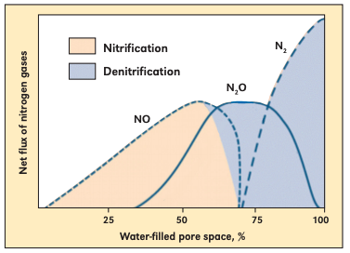
Denitrification: NO₃ → NO, N₂O → N₂
Occurs under high NO₃ and low O₂ conditions (e.g., high soil moisture)
Bouwman (1998)

Slide 28
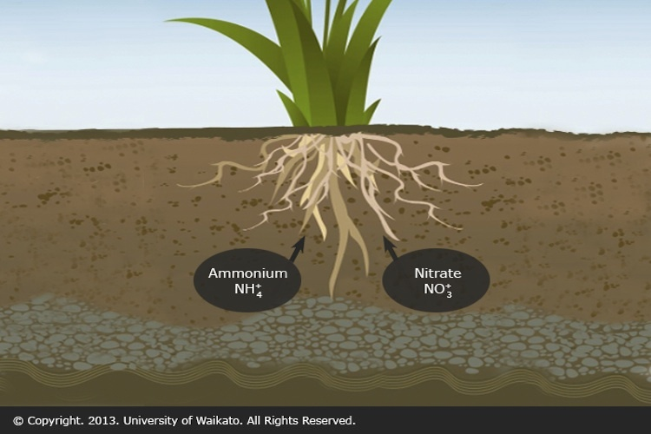
Assimilation: Inorganic N → Organic N
Via microbes or plants

Slide 30
Ammonification + Nitrification = Mineralization

Slide 31
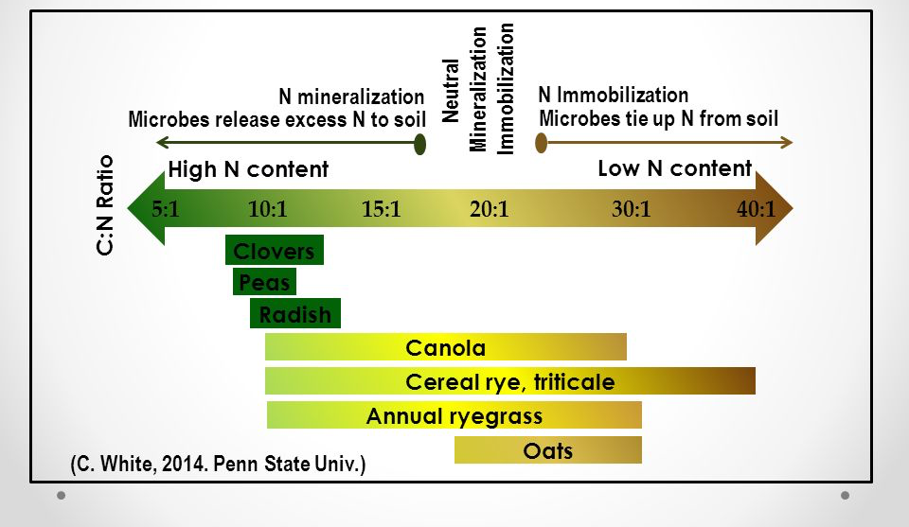
Assimilation: Inorganic N → Organic N Mineralization: Organic N → Inorganic N
Whether you have net mineralization or assimilation depends on the environment
High N = mineralization
Low N = assimilation

Slide 32
Gross Mineralization = Total amount of N released by mineralization (NH₄⁺ and NO₃⁻)
Net mineralization = Gross – immobilization – losses (NH₄⁺ and NO₃⁻)
Net mineralization = available for plant uptake

Slide 33
Linking above- and belowground processes

Slide 34
Linkages between above- and belowground processes
Litterfall-ANPP & Litter quality
Decomposition
Microbial/decomposer activity
DON

Slide 35
Linkages between above- and belowground processes
Rate Limiting Step to N cycling ?
Depolymerization
Litterfall-ANPP & Litter quality
Decomposition
Microbial/decomposer activity
DON

Slide 36
DON
Bacteria and fungi secrete extracellular enzymes to break
complex polymers down into water soluble units that can
pass through cell membranes
Proteases Proteins Amino acids
Ribonucleases Nucleic acids Nucleotides
Chitinases Chitins
Cellulase N polymers

Slide 37
High protease activity yields more amino acids
Kielland 2006

Slide 38
Fate of DON???

Slide 39
Fate of DON
Taken up by mycorrhizae

Slide 40
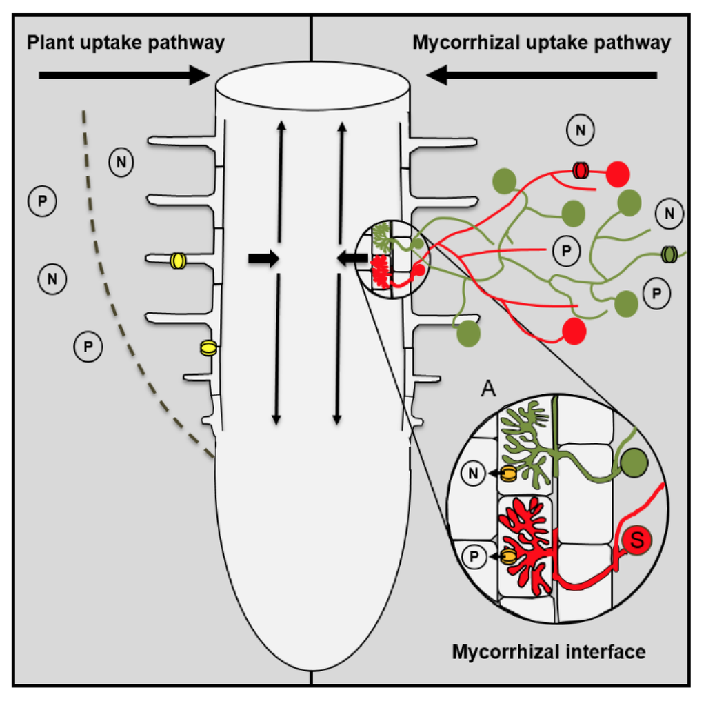
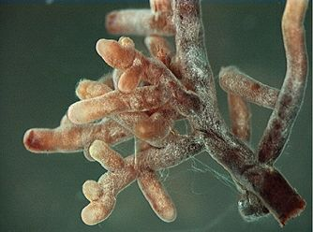
Linkages between above- and belowground processes
DON
Uptake by ECM & plants
Notes:
Taken up by plant (not too common)
Taken up by mycorrhiza
Leached to gw
Absorbed to soils
Taken up by microbes

Slide 41
Fate of DON
Taken up by mycorrhizae
Mineralized by microbes

Slide 42
Nitrogen Mineralization
•N Mineralization results from microbial break-down of DON
•Microbes release NH₄⁺ to soil solution as they use carbon
Organic-N
(R-NH₂) NH₄⁺
Mineralization
(ammonification)

Slide 43
Linkages between above- and belowground processes
CO₂
DON
NH₄⁺
Ammonification
Notes:
Taken up by plant (not too common)
Taken up by mycorrhiza
Leached to gw
Absorbed to soils
Taken up by microbes

Slide 44
Fate of DON
Taken up by mycorrhizae
Mineralized by microbes
Leached (not too common)

Slide 45
Fate of NH₄⁺???

Slide 46
Fate of NH₄⁺
Nitrified by microbes

Slide 47
Linkages between above- and belowground processes
DON
NO₂⁻
NH₄⁺
NO₃⁻
Nitrification
Ammonification
Mineralization
Notes:
Taken up by plant (not too common)
Taken up by mycorrhiza
Leached to gw
Absorbed to soils
Taken up by microbes

Slide 48
Fate of NH₄⁺
Nitrified by microbes
Assimilated up by microbes (not too common)
Assimilated up by plants (not too common)
Leached (not too common)

Slide 49
Fate of NO₃⁻???
Notes:
)

Slide 50
Fate of NO₃
Assimilated by plants

Slide 51
Linkages between above- and belowground processes
Assimilation
DON
NO₂⁻
NH₄⁺
NO₃⁻
Nitrification
Ammonification
Mineralization
Notes:
Taken up by plant
Immobilized
Leached to gw (very mobile)
Absorbed to soils
Reduced by denitrifying microbes to N2, Nox, N20

Slide 52
Fate of NO₃
Assimilated by plants
Denitrified by microbes
Leached

Slide 53
Linkages between above- and belowground processes
Assimilation
N₂
DON
NO_{x}
N₂O
NO₂⁻
NH₄⁺
De-Nitrification
NO₃⁻
Nitrification
Ammonification
Leached to groundwater
Mineralization
Notes:
Taken up by plant
Immobilized
Leached to gw (very mobile)
Absorbed to soils
Reduced by denitrifying microbes to N2, Nox, N20

Slide 54
Speed of N cycling

Slide 55
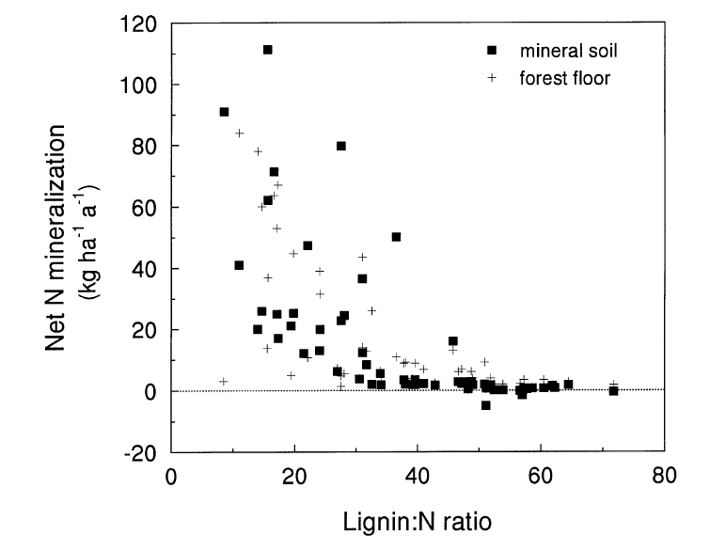
Litter quality increases N cycling
Scott & Binkley 1997

Slide 56
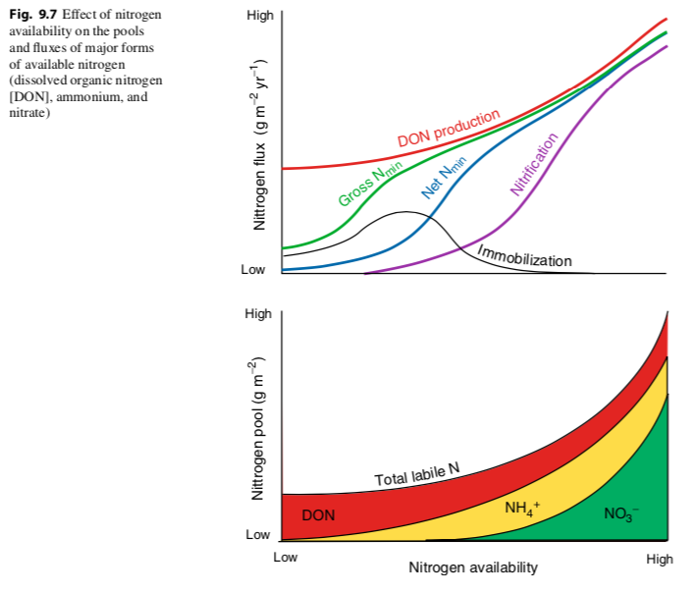

Slide 57
Temperature increases N cycling

Slide 58
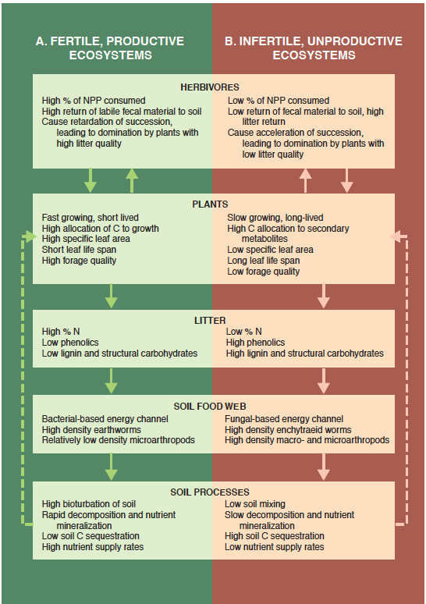
Fast Cycling Systems
Slow Cycling Systems

Slide 59
Why might organisms manipulate the speed of N cycling?

Slide 63
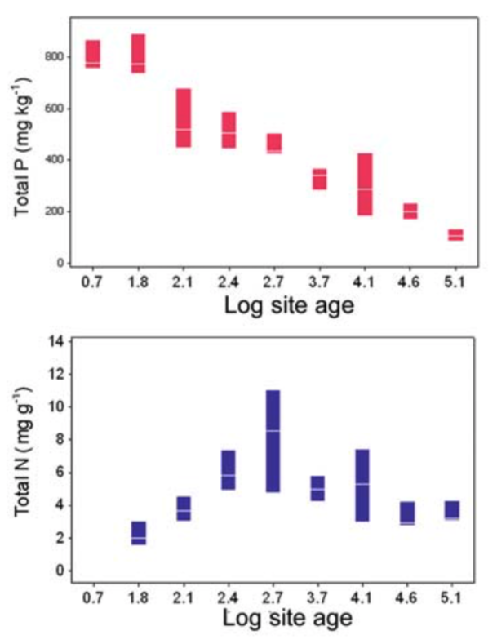
Most P enters systems through recycling

Slide 65
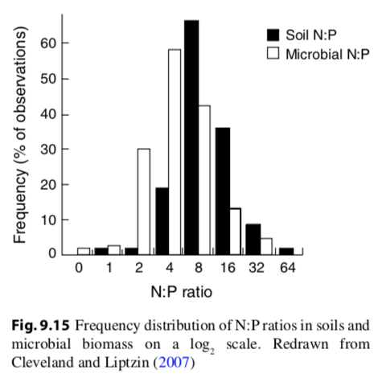
Microbes have a ton of P!
Microbial P = 20-30% total ecosystem P
Microbial N = 4% total ecosystem N
Microbial C = 2% total ecosystem C
Microbial N:P = 7:1
Plant N:P = 28:1

Slide 66
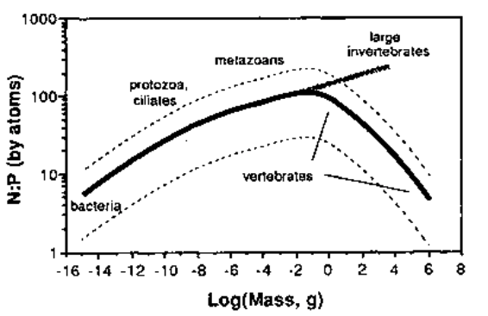
N:P tends to increase with organism size…

Slide 67
…but vertebrates are weird!

Slide 68
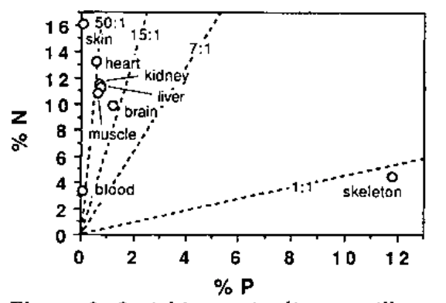

Slide 70
Mycorrhizae are very important for plant P uptake
Exchange P for C
Define the plant-soil P interface
Vessicular – arbuscular mycorrhizal fungi

Slide 71
Mycorrhizae are very important for plant P uptake
Arbuscule
(exchange site)
Vesicle
(storage)
Vessicular – arbuscular mycorrhizal fungi

Slide 73
Ectomycorrhizae get relatively more N than P
Arbuscular mycorrhizae get relatively more P than N

Slide 74
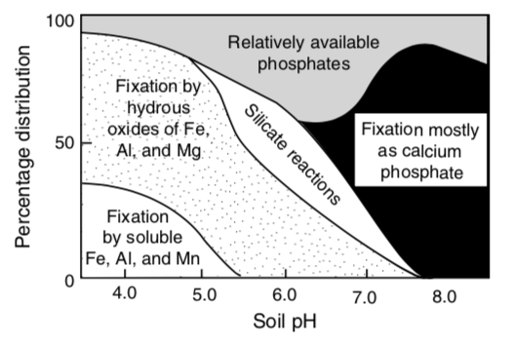
P binds to things, is more available at moderate pH

Slide 75
Agriculture

Slide 76
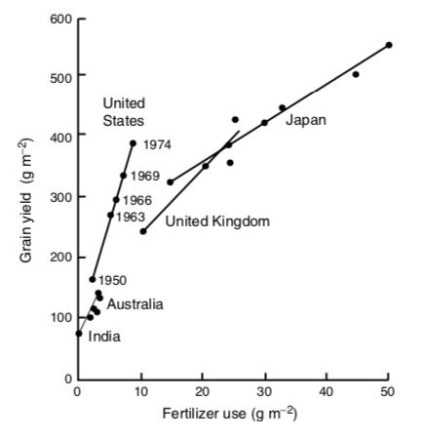

Slide 77
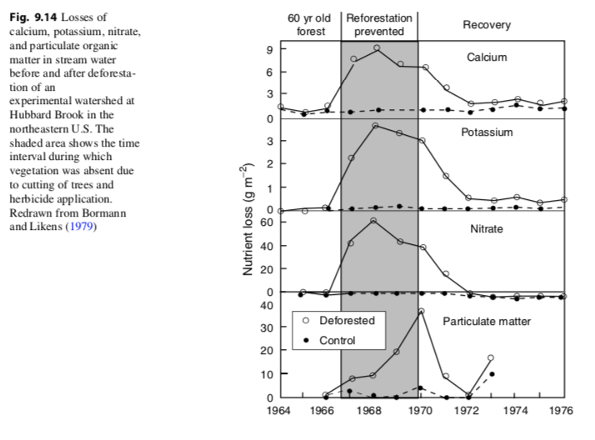

Slide 78
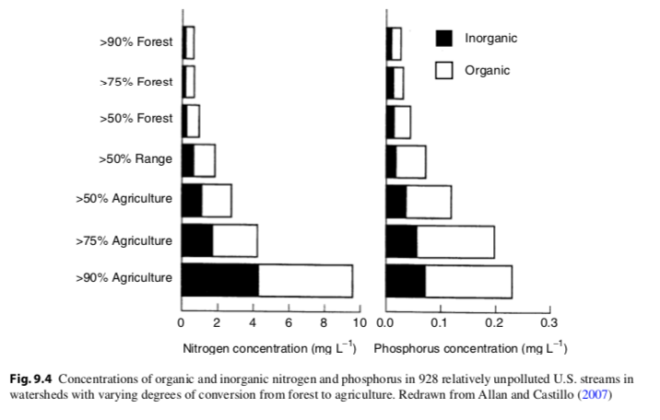

Slide 79
From agriculture and fossil fuel burning
NOAA

Slide 80
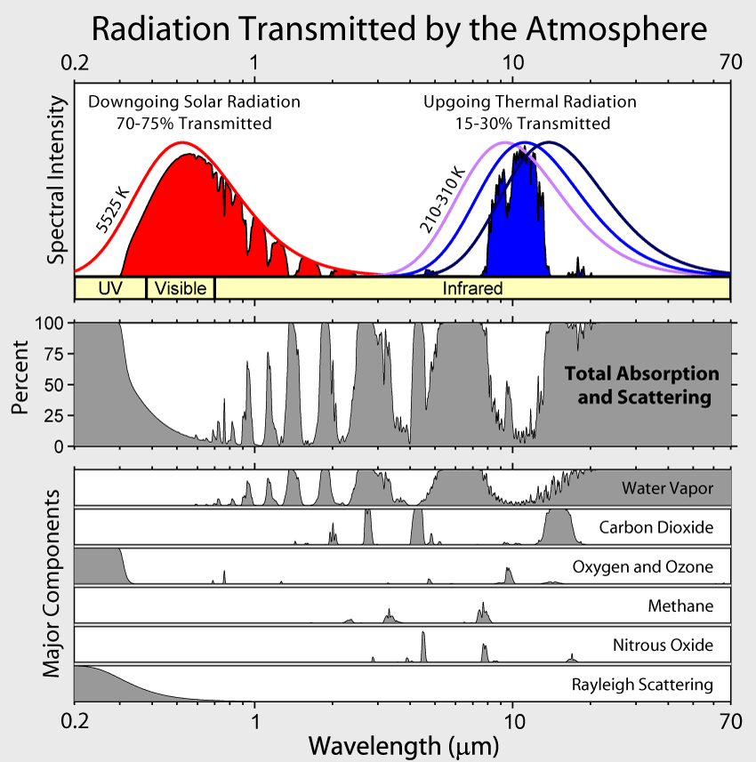

Slide 82
What might be the ecosystem impacts of fertilizer use?

Slide 83
How do we avoid these?

Slide 84
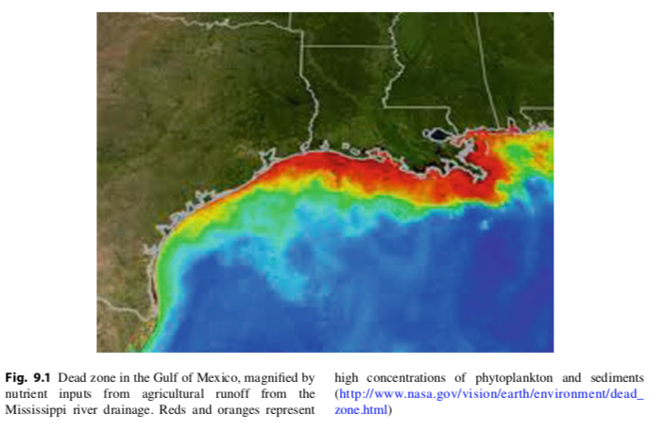

Slide 85
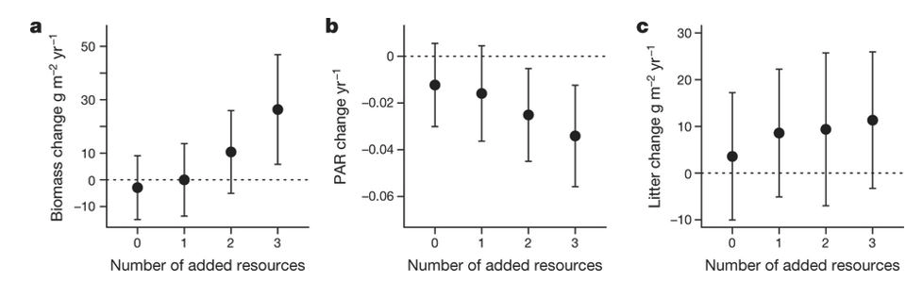
Harpole et al. (2016)

Slide 86
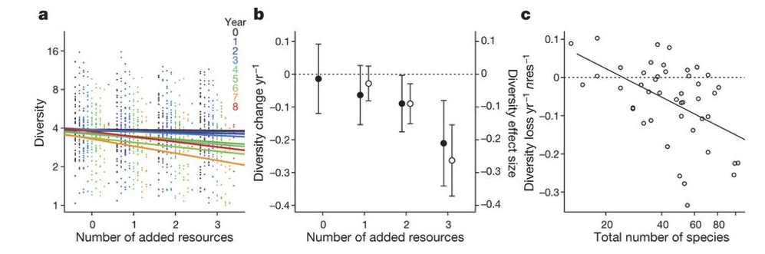
Harpole et al. (2016)

